Slide 1

HR ANALYTICS
by Subrata Mondal

Slide 2
This is a data analysis project that aims to improve the hiring process of a multinational company such as Google by exploring the trends and patterns in their hiring data.
The project will use statistical methods and Excel formulas to answer research questions such as the number of rejections, interviews, types of jobs, vacancies, etc. To explore the trends and patterns in the data and provide recommendations and insights for the company.
The project will also contribute to the literature on hiring data analysis for multinational companies.
PROJECT
DESCRIPTION

Slide 3
The project will follow these steps or phases:
Data preparation: In this phase, I will import the data into Excel and perform data cleaning
and transformation tasks such as checking for missing values, outliers, duplicates, errors, etc.
Data analysis: In this phase, I will perform data analysis tasks such as applying statistical
methods and formulas to answer the research questions and objectives. I will also interpret
and explain the results and findings of the data analysis with the help of Excel itself.
Data reporting: In this phase, I will write a detailed report that summarizes the data analysis
results and findings, provides insights, approach, tech-stack used and the result that will be
represented.
Data presentation: In this phase, I will present the report and the presentation to the
company’s hiring department and other stakeholders or users of the project results. I will also
answer any questions or queries they may have and collect their feedback.
NOTE: This MS Powerpoint represents the steps, Data Reporting and Data Presentation.

Slide 4
Exploratory Data Analysis (EDA)
COLUMNS | TYPES
application_id | numerical
Interview Taken on | datetime
Status | categorical
event_name | categorical
Department | categorical
Post Name | categorical
Offered Salary | numerical
event_name | Count of event_name
- | 10
Don’t want to say | 268
Female | 1856
Male | 2563
Grand Total | 4697
Department | Count of Department
Finance Department | 176
General Management | 113
Human Resource Department | 70
Marketing Department | 202
Operations Department | 1843
Production Department | 246
Purchase Department | 230
Sales Department | 485
Service Department | 1332
Grand Total | 4697
Interview Taken on | Count of Interview Taken on
May | 1095
Jun | 1079
Jul | 1296
Aug | 1227
Grand Total | 4697

Slide 5
Post Name | Count of Post Name
- | 1
b9 | 308
c-10 | 105
c5 | 1182
c8 | 193
c9 | 1239
i1 | 151
i4 | 32
i5 | 511
i6 | 337
i7 | 635
m6 | 2
n6 | 1
Grand Total | 4697
Descriptive Statistics of Offered Salary (Hired Employees)
Min | 100
Max | 400000
Range | 399900
Mean | 49983.02902
Median | 49625
Mode | 72843
Variance | 832563524
Std. Deviation | 28854.17689
1st Quartile | 25460.5
2nd Quartile | 49625
3rd Quartile | 74438
Inter-Quartile Range | 48977.5

Slide 6
A. Hiring: Process of intaking of people into an organization for different kinds of positions. Task: How many males and females are Hired ?

Slide 7
Average Salary: Adding all the salaries for a select group of employees and then dividing
the sum by the number of employees in the group. Task: What is the average salary offered in this company ?
49983.03
Average Salary

Slide 8
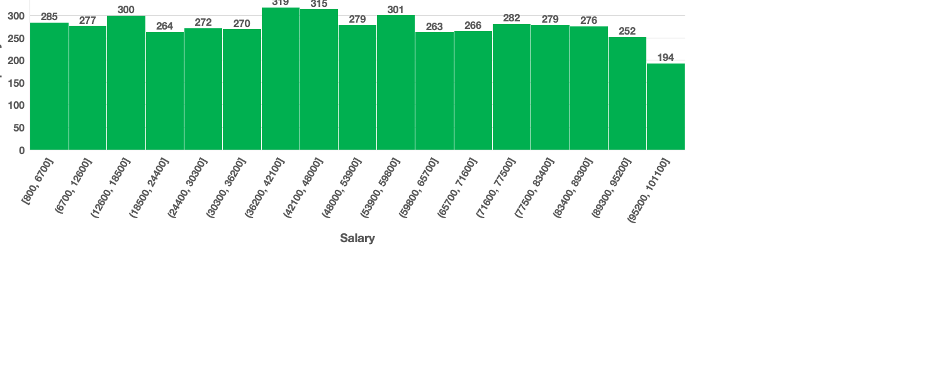
Class Intervals: The class interval is the difference between the upper class limit and the lower class limit. Task: Draw the class intervals for salary in the company ?

Slide 9
D. Charts and Plots: This is one of the most important part of analysis to visualize the data. Task: Draw Pie Chart / Bar Graph ( or any other graph ) to show proportion of people
working different department ?

Slide 10
E. Charts: Use different charts and graphs to perform the task representing the data. Task: Represent different post tiers using chart/graph?

Slide 11
Data collection: The data for this project was obtained from the company containing data for different regions and departments. The data was downloaded in XLSX format and imported into Excel for analysis.
Data cleaning: The data was checked for missing values, outliers, duplicates, and errors.
Data analysis: The data was analyzed using various statistical methods and Excel formulas to calculate descriptive statistics, such as mean, median, mode, standard deviation, range, IQR, etc. The data was also visualized using tables, pivot tables, charts, and pivot charts to explore the trends and patterns in the hiring process.
APPROACH

Slide 12
Data interpretation: The results of the data analysis were interpreted and discussed in relation to the research questions and objectives of the project. The findings were also compared and contrasted with the existing literature on hiring data analysis for multinational companies.
Data presentation: The final report of the project was prepared using MS PowerPoint. The report included an project description, approach, tech-stack used, insights and results. The report also included relevant tables, charts, and graphs to illustrate the findings and recommendations of the project.

Slide 13
TECH STACK
USED
Microsoft Powerpoint: 16.72
Microsoft Excel: 16.72

Slide 14
The project aimed to analyze the hiring data of a multinational company and provide insights and recommendations to improve the hiring process and outcomes. The project followed a systematic approach of data collection, cleaning, analysis, interpretation, and presentation using Excel and PowerPoint. The main insights and results of the project are summarized below:
Total number of candidates reviewed for hiring are 7168.
Out of them 4697 got hired from which male represents 55% and female represents 39%.
Average and median salary offered to the hired employees are 49983.03 and 49625 respectively.
INSIGHTS

Slide 15
The project analyzed the hiring data of a multinational company using Excel and PowerPoint. It followed four phases: data preparation, data analysis, data reporting, and data presentation. It answered the research questions and objectives about the hiring process and outcomes. It also provided insights and recommendations based on the data analysis results and findings. It used statistical methods and Excel formulas to calculate and visualize descriptive statistics. The main results and findings were:
7168 candidates were reviewed for hiring and 4697 were hired (55% male and 39% female).
RESULT

Slide 16
The offered salary to the hired employees had:
A Min of 100,
A Max of 400000,
A Range of 399900,
A Mean of 49983.03,
A Median of 49625,
A Mode of 72843,
A Variance of 832563524,
A Std. Deviation of 28854.18,
A 1st Quartile of 25460.5,
A 2nd Quartile of 49625,
A 3rd Quartile of 74438, and
An IQR of 48977.5.

Slide 17
Thank You

